Slide 1
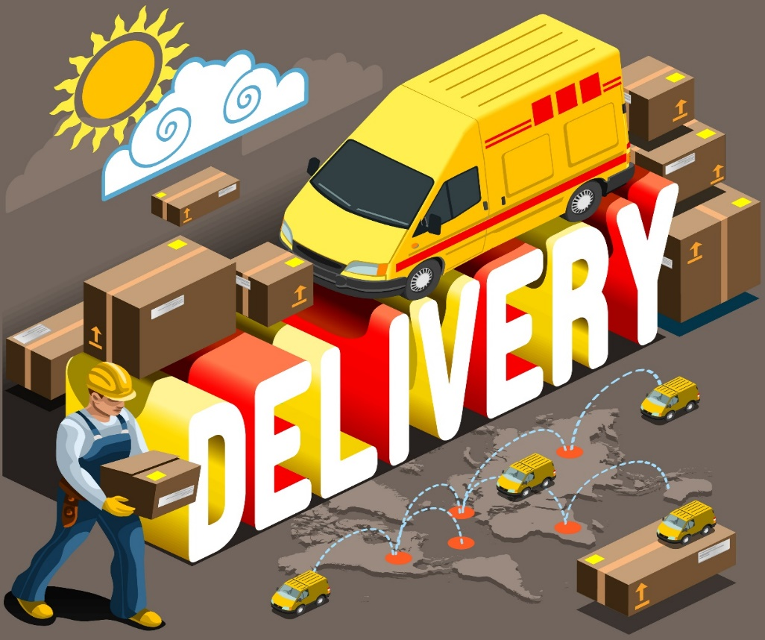
UDP
DatagramPacket
DatagramSocket
The Packet Buffer

Slide 2
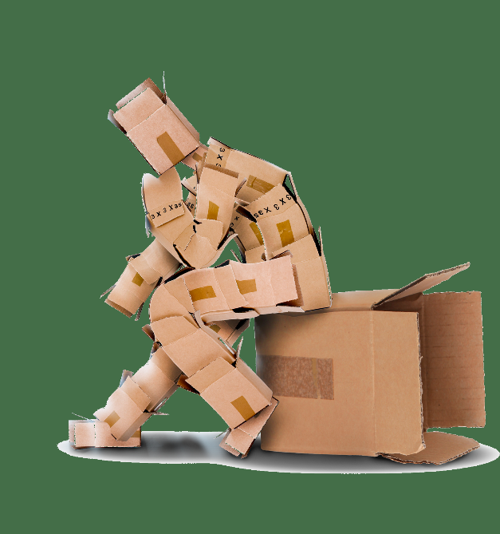
See Also
https://docs.oracle.com/javase/tutorial/networking/datagrams/clientServer.html
http://www.binarytides.com/udp-socket-programming-in-java/

Slide 3
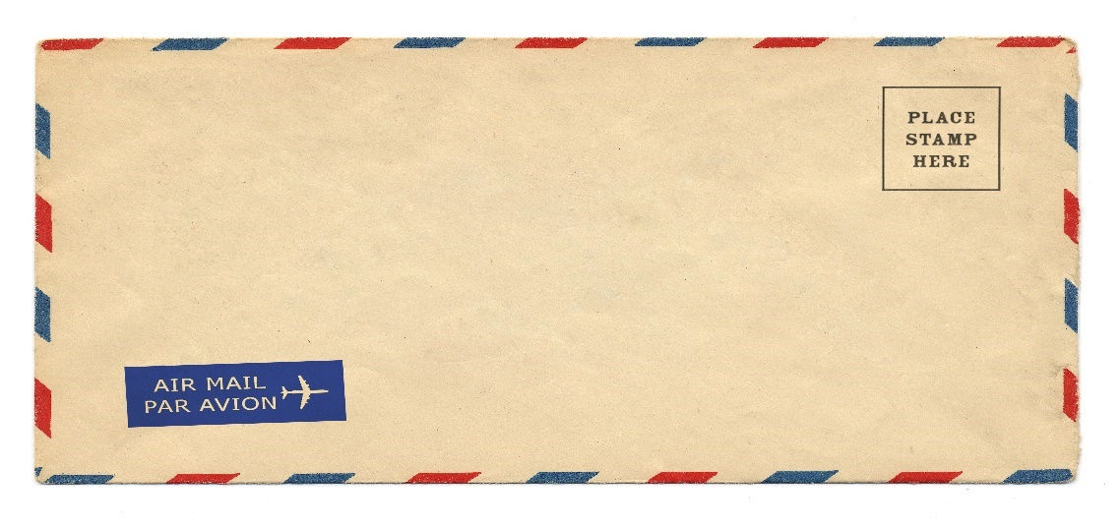

DatagramPacket
Address
Port
Data
Offset
Length
byte []
C2
05
FF
23
B7
…
45
Buffer is an array of bytes
You can use a smaller part of the buffer
Address/Port is the “other” machine (sender or receiver)
Streams of bytes … two ways (into your program and out of your program)
Disks, consoles, sockets, keyboards, printers
Know how to talk streams and you can talk to anything
Initialization (constructor) is different. Use is the same.

Slide 4
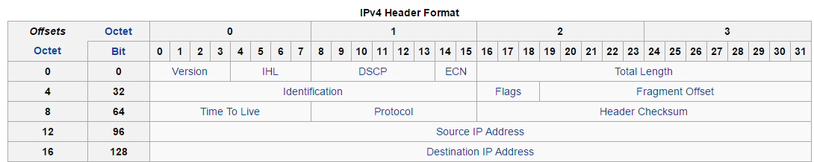
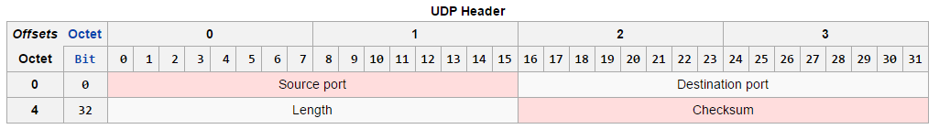
DatagramPacket
UDP Payload
65535 - 20 - 8 = 65507
Packets may be fragmented around the MTU size
The OS reassembles the fragments for you
Streams of bytes … two ways (into your program and out of your program)
Disks, consoles, sockets, keyboards, printers
Know how to talk streams and you can talk to anything
Initialization (constructor) is different. Use is the same.

Slide 5
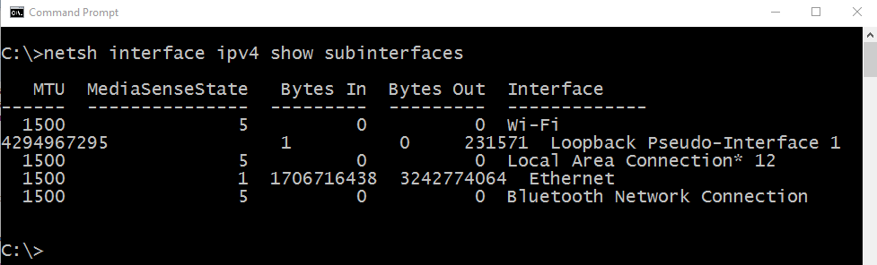
DatagramPacket
Streams of bytes … two ways (into your program and out of your program)
Disks, consoles, sockets, keyboards, printers
Know how to talk streams and you can talk to anything
Initialization (constructor) is different. Use is the same.

Slide 6


DatagramSocket
10.10.2.1:2755
80.7.45.2:4444
DatagramSocket
DatagramSocket
send()
receive()
80.7.45.2
4444
10.10.2.1
2755
DatagramPacket
DatagramPacket
byte []
byte []
Both sender and receiver need to build a packet
Data and address are filled in for the receiver
You can reuse the packet objects over and over
Streams of bytes … two ways (into your program and out of your program)
Disks, consoles, sockets, keyboards, printers
Know how to talk streams and you can talk to anything
Initialization (constructor) is different. Use is the same.

Slide 7

UDP
Streams of bytes … two ways (into your program and out of your program)
Disks, consoles, sockets, keyboards, printers
Know how to talk streams and you can talk to anything
Initialization (constructor) is different. Use is the same.

Slide 8
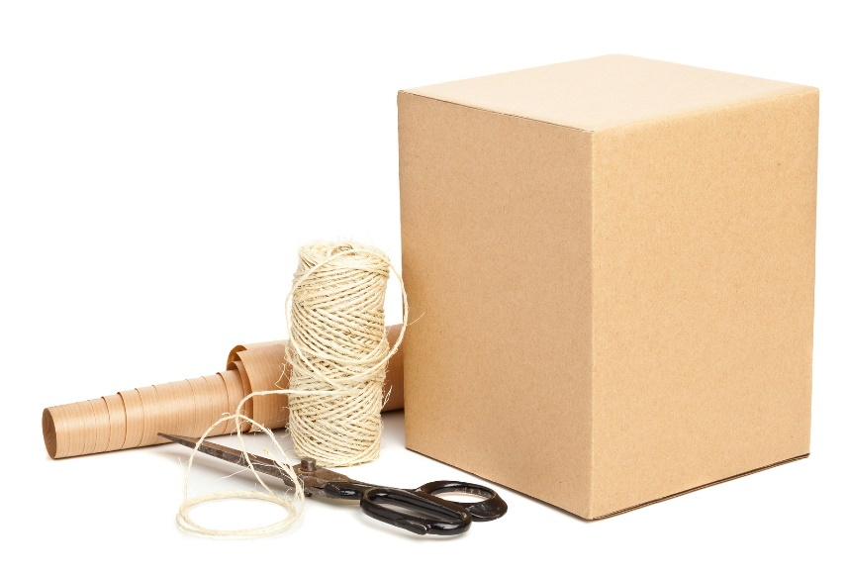
Tinkering
Make a “date” server that listens on port 7777. As soon as someone connects, return a string with the current date and time.
What information would you need to send between server and client for a remote TicTacToe player?
Notes:
Reference the discussion area

